Slide 1


Mastering Flutter: From Beginner to Pro.
joeshwoa.george@gmail.com
Session 11: Core Flutter Widgets

Slide 2
Do not skip any information without understanding it.
joeshwoa.george@gmail.com
― Joeshwoa George

Slide 3
Any questions?
joeshwoa.george@gmail.com
Don;t forget study this section well and write your questions in note and i will answer it in live session.

Slide 4
Table of Contents.
Basic Widgets
Layout and Container Widgets
Scaffold Widget
Q&A and Wrap-Up
01
02
Text, Image, Column, Row, ListView.
Container, Stack.
03
04
Scaffold Widget, Building a Sample App.
Let's ask
joeshwoa.george@gmail.com

Slide 5
Basic Widgets.
01
Let’s Start with
What Are Widgets?
joeshwoa.george@gmail.com

Slide 6
What Are Widgets?
The building blocks of Flutter apps.
Divided into:
Stateless Widgets: Immutable, do not change state.
Stateful Widgets: Can rebuild when the state changes.
joeshwoa.george@gmail.com

Slide 7
Flutter Widget Hierarchy
Root widget: MaterialApp or CupertinoApp.
Scaffold as the basic layout.
Nested widgets to create the UI.
joeshwoa.george@gmail.com

Slide 8
Text Widget
Displays simple or styled text.
Example:
Text(
'Hello, Flutter!',
style: TextStyle(fontSize: 24, fontWeight: FontWeight.bold, color: Colors.blue),
);
joeshwoa.george@gmail.com

Slide 9
Image Widget
Displays images from assets, network, or memory.
Example:
Image.asset('assets/images/flutter_logo.png');
Image.network('https://flutter.dev/images/flutter-logo-sharing.png');
joeshwoa.george@gmail.com

Slide 10
Column Widgets
Column: Arranges children vertically.
Example:
Column(
children: [
Text('Item 1'),
Text('Item 2'),
Text('Item 3'),
],
)
joeshwoa.george@gmail.com

Slide 11
Row Widgets
Row: Arranges children horizontally.
Example:
Row(
children: [
Icon(Icons.star, color: Colors.yellow),
Text('Star Rating'),
],
)
joeshwoa.george@gmail.com

Slide 12
ListView Widget
Creates a scrollable list of items.
Example:
ListView(
children: [
ListTile(title: Text('Item 1')),
ListTile(title: Text('Item 2')),
ListTile(title: Text('Item 3')),
],
)
joeshwoa.george@gmail.com

Slide 13
Layout and Container Widgets.
02
Let’s Start with
Container Widget
joeshwoa.george@gmail.com

Slide 14
Container Widget
Used for styling, alignment, and positioning.
Example:
Container(
width: 100,
height: 100,
color: Colors.blue,
child: Center(child: Text('Box')),
)
joeshwoa.george@gmail.com

Slide 15
Stack Widget
Allows widgets to overlap.
Example:
Stack(
children: [
Container(width: 100, height: 100, color: Colors.red),
Positioned(
top: 10,
left: 10,
child: Container(width: 50, height: 50, color: Colors.blue),
),
],
)
joeshwoa.george@gmail.com

Slide 16
Scaffold Widget.
03
Let’s Start with
Scaffold Widget
joeshwoa.george@gmail.com

Slide 17
Scaffold Widget
Provides a structure for Material Design apps.
Contains AppBar, FloatingActionButton, Drawer, etc.
joeshwoa.george@gmail.com

Slide 18
Scaffold Widget
Example:
Scaffold(
appBar: AppBar(
title: Text('Flutter Scaffold'),
),
body: Center(
child: Text('Hello, Scaffold!'),
),
floatingActionButton: FloatingActionButton(
onPressed: () {},
child: Icon(Icons.add),
),
)
joeshwoa.george@gmail.com

Slide 19
Building a Sample App
Example:
Scaffold(
appBar: AppBar(
title: Text('Core Widgets Example'),
),
body: Column(
children: [
Text(
'Welcome to Flutter',
style: TextStyle(fontSize: 24, fontWeight: FontWeight.bold),
),
Image.network('https://flutter.dev/images/flutter-logo-sharing.png'),
joeshwoa.george@gmail.com

Slide 20
Building a Sample App
Example:
Row(
mainAxisAlignment: MainAxisAlignment.spaceEvenly,
children: [
Icon(Icons.thumb_up, color: Colors.green),
Icon(Icons.thumb_down, color: Colors.red),
],
),
joeshwoa.george@gmail.com

Slide 21
Building a Sample App
Example:
Expanded(
child: ListView(
children: [
ListTile(title: Text('List Item 1')),
ListTile(title: Text('List Item 2')),
ListTile(title: Text('List Item 3')),
],
),
),
],
),
);
joeshwoa.george@gmail.com

Slide 22
Q&A and Wrap-Up.
04
Let’s Start with
Any questions in this session?
joeshwoa.george@gmail.com

Slide 23
Homework
Create a Flutter app with:
A Scaffold containing an AppBar with the title "Core Widgets".
A Column with:
A Text widget displaying "Homework App".
An Image.asset widget displaying a local image.
A Row with three icons.
joeshwoa.george@gmail.com

Slide 24
Homework
A ListView of at least 10 items
Each item is a Container with a unique background color and text.
joeshwoa.george@gmail.com

Slide 25
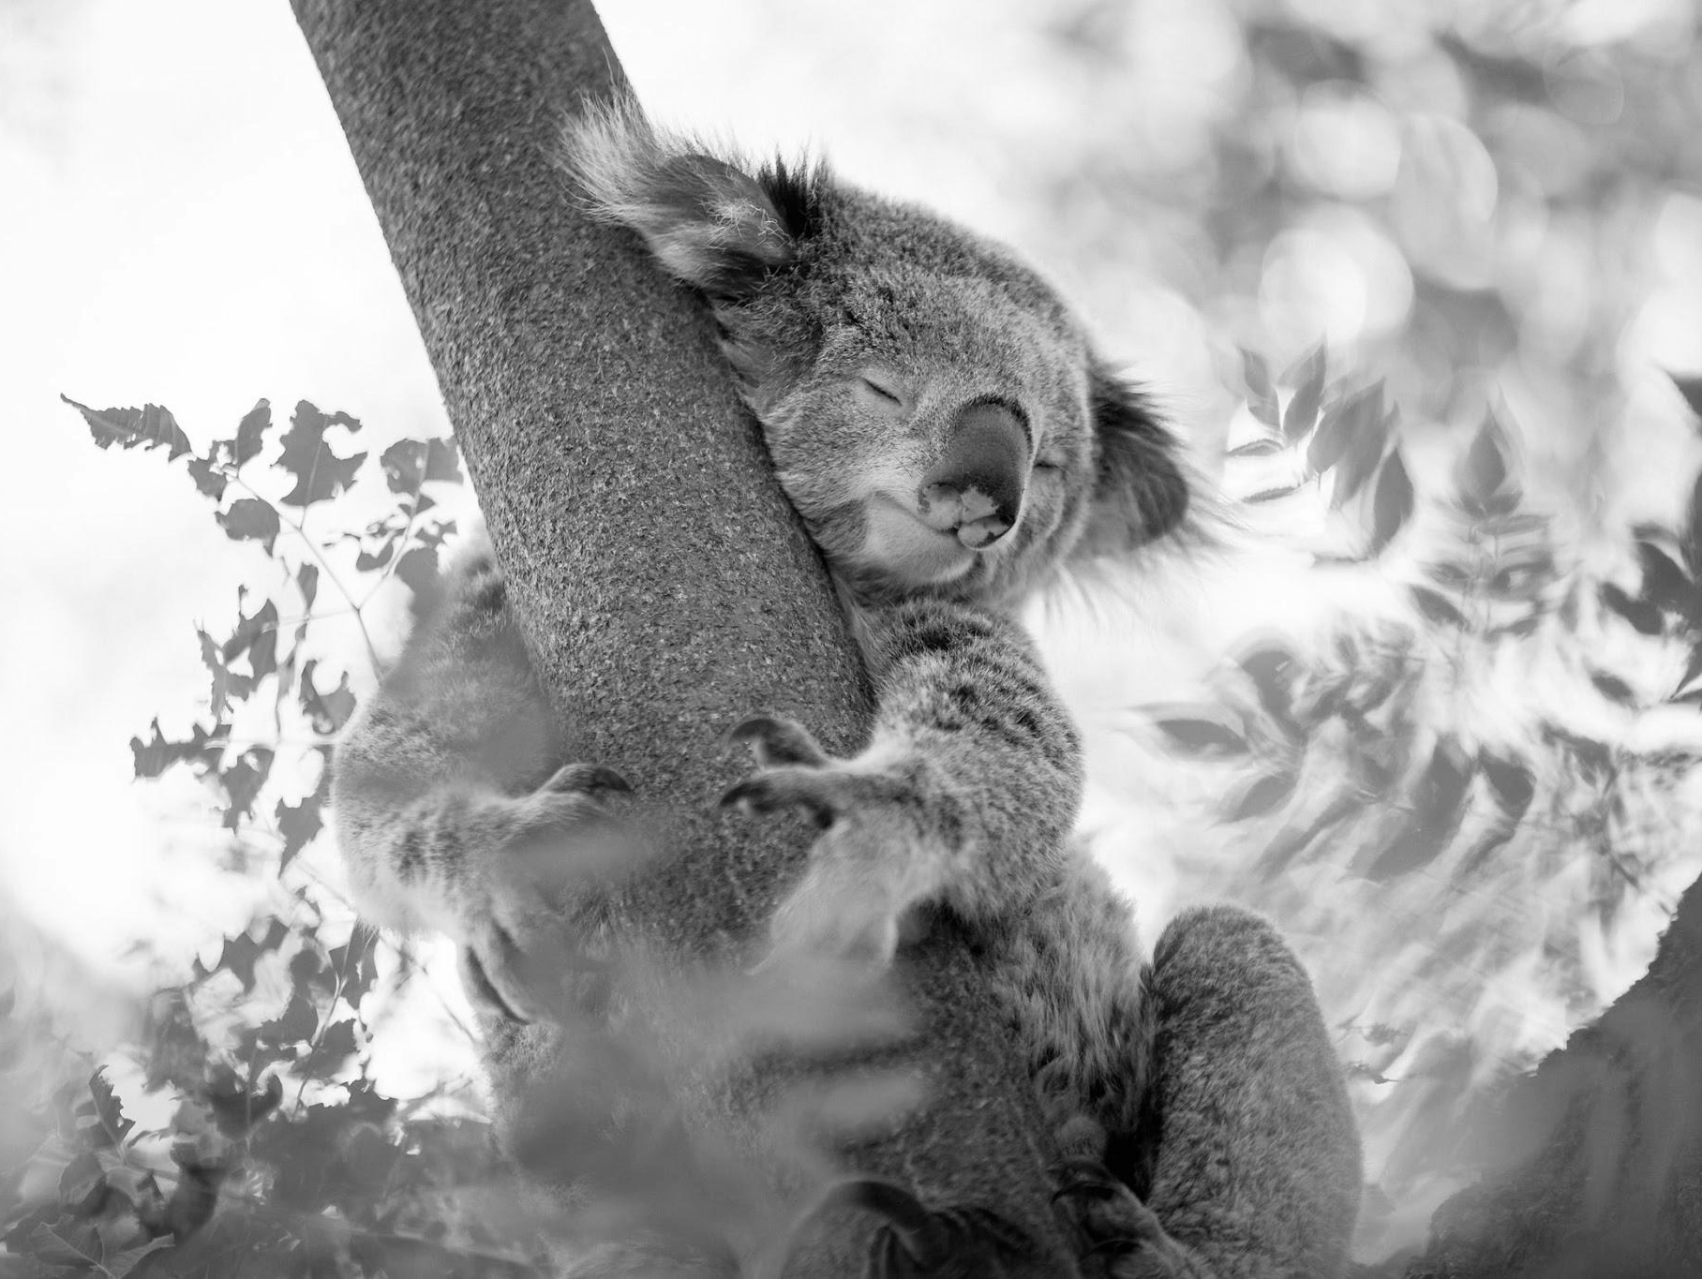
OFFFFF Take a brack.
joeshwoa.george@gmail.com
Only Koalas don’t have much energy and, Koala can sleep for up to 18 hours a day but you only need 6-8 hours to have all energy needed energy for one day.

Slide 26
So, Don’t Wast Your Time in Sleep.
joeshwoa.george@gmail.com
― Joeshwoa George

Slide 27
See you next session!
joeshwoa.george@gmail.com
Don;t forget study this section well and write your questions in note and i will answer it in live session.

Slide 28

Thank you!
Do you have any questions?
joeshwoa.george@gmail.com
+20 120 294 6596
joeshwoa.george@gmail.com

